Slide 1
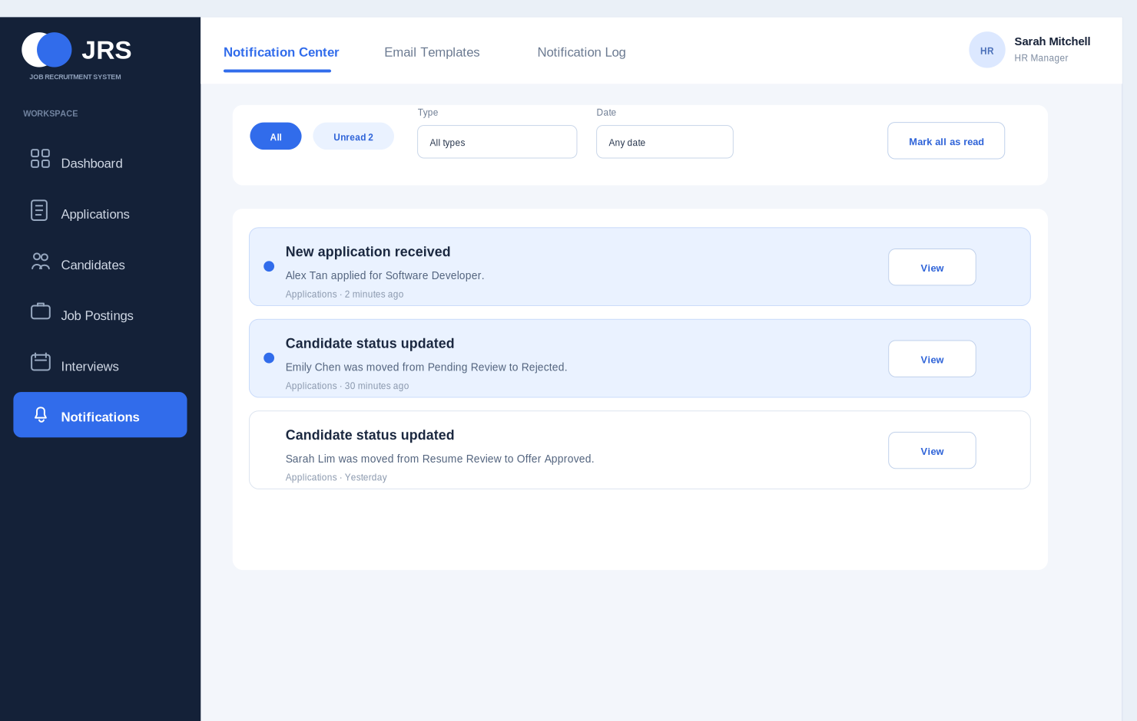
● JRS
Individual Presentation
Notification Module
& HR Profile
Zhao Yikai | C3543471
Scope refined
Connected workflow
Ready for Part B
Notes:
My name is Zhao Yikai, and today I will share the part of the JRS project that I completed during the interim phase. I will mainly explain what I designed, how I refined the scope, and how my work connects with the wider system.

Slide 2
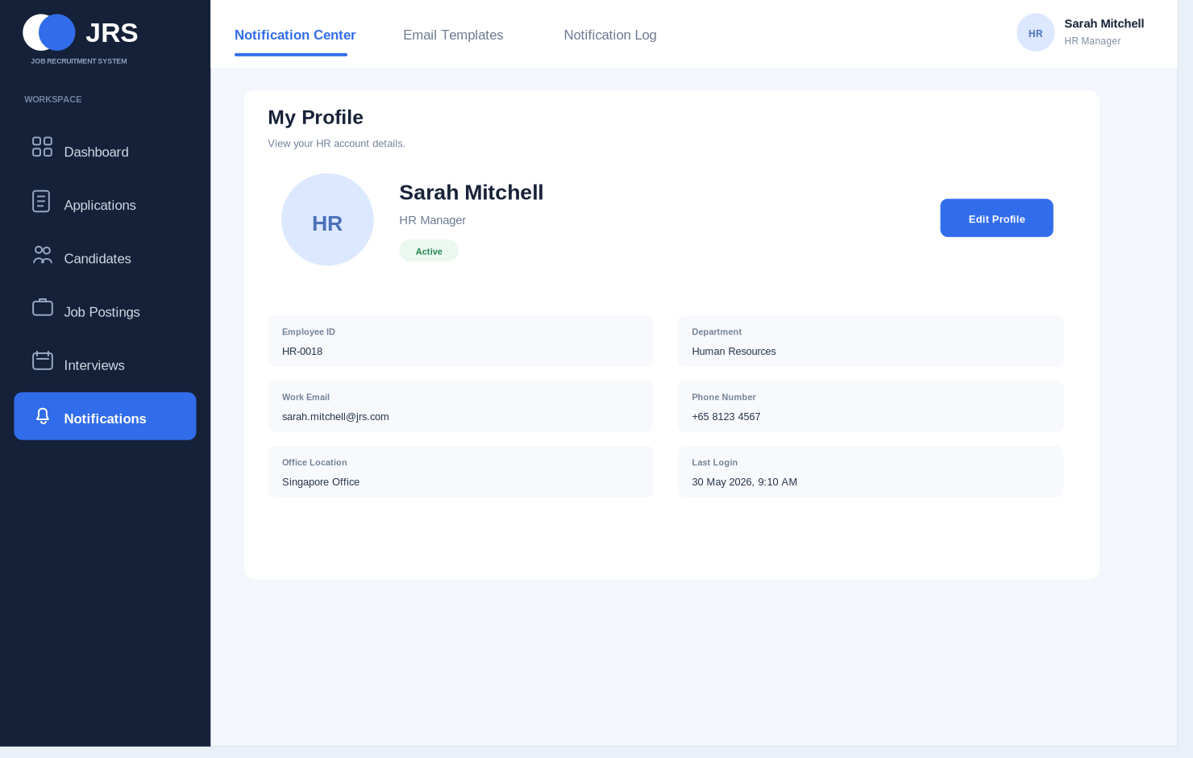
My responsibility inside JRS
My assigned area
Help HR follow important updates
Track emails sent to candidates
Complete account pages from avatar
Keep one consistent HR workspace
Main idea
My work gives HR a clear place to see what changed, check previous messages, and manage their account information.
Notification
Profile
JRS Individual Presentation | Zhao Yikai
2
Notes:
For my individual contribution, I worked on the HR notification module. The aim was to give HR a clear place to follow important updates and keep track of emails sent to candidates. I also designed the profile pages linked to the avatar in the top-right corner. Since these pages are part of the same HR workspace, I kept the layout and visual style consistent so the whole section feels connected and easy to use.

Slide 3
Scope refinement
Before refinement
After refinement
The first version repeated work that belonged to Applications or Interviews, so the boundary was unclear.
The final version keeps a smaller purpose, which is easier to explain and easier to integrate with the team work.
→
Removed from my module
Kept in my module
Candidate decisions, interview scheduling, reminders, offer approval, and contract creation.
System updates for HR, standard email wording, sent-message history, and account pages.
JRS Individual Presentation | Zhao Yikai
3
Notes:
The first challenge was defining my scope of work, as my initial design repeated several features that other team members had already covered. After comparing our interfaces and discussing workflows, I removed these overlaps, retaining a smaller, clearer scope. This allowed me to focus on the actual purpose of my module and reduced the chance of duplicated work when the team begins system integration.

Slide 4
Final connected flow
Applications event
Notification Center
Email support
Notification Log
New application or status update
HR sees what happened
Saved wording helps candidate message
Record can be checked later
Key rule
My module does not make recruitment decisions. It informs HR, supports candidate messages, and stores the final sending record.
JRS Individual Presentation | Zhao Yikai
4
Notes:
After that change, the process became simple: another part of the system handles the recruitment decision, my area tells HR what happened, supports the message sent to the candidate, and keeps a record that can be checked later. For example, when an application moves to a new stage, HR can see the update, review the related message, and later confirm what was sent.

Slide 5
Notification Center
Why it matters
HR may handle many applications in one day, so important changes need to be visible without searching across different pages.
New applications appear here
Unread updates are easy to notice
View opens the related application
System updates only
JRS Individual Presentation | Zhao Yikai
5
Notes:
This page gives HR a quick overview of what has changed. New applications and status updates appear in one place, unread items are easy to notice, and HR can open the related application directly when more details are needed. I designed it this way because HR may need to review many applications during the day, so important changes should be easy to find without searching through several different pages.

Slide 6
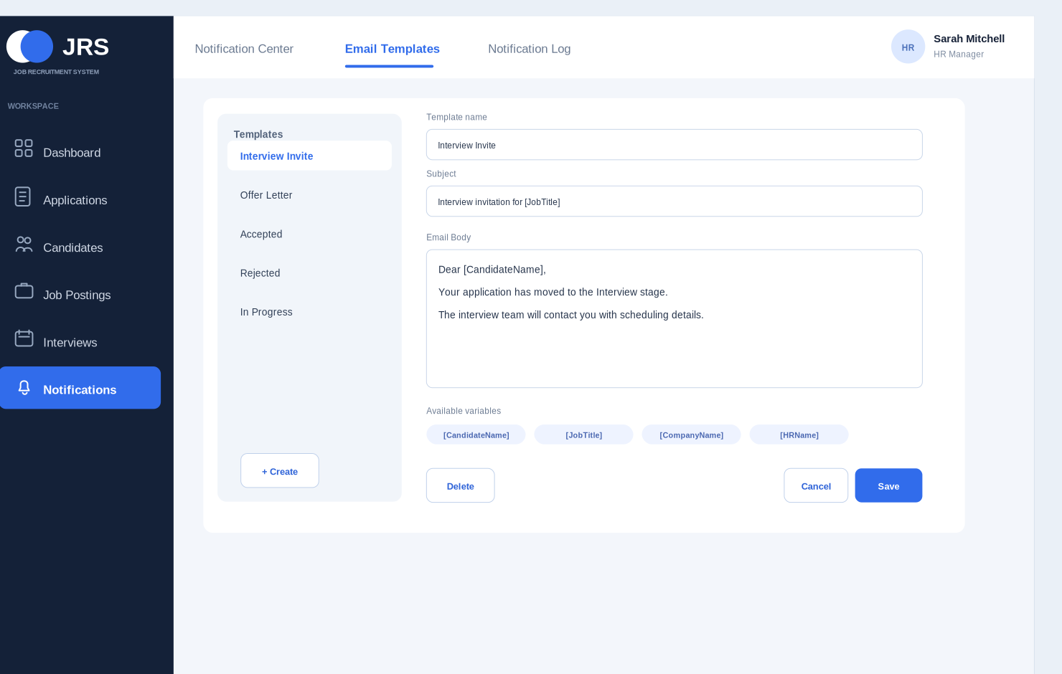
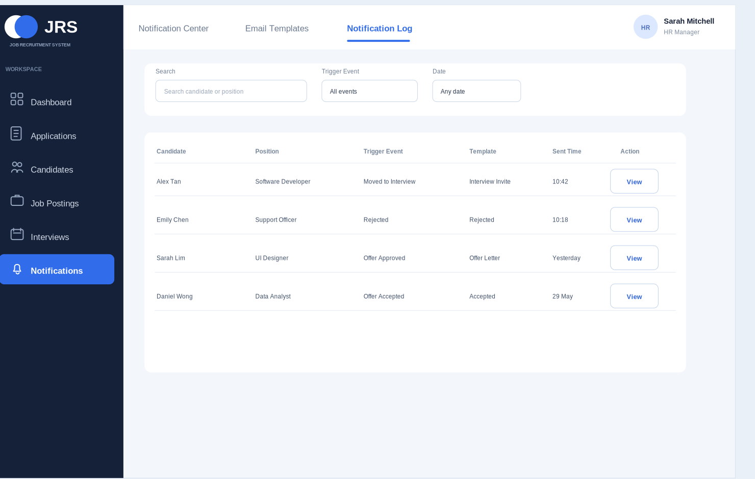
Email Templates and Notification Log
Prepare standard wording once
Review what was sent later
This reduces inconsistent messages and gives HR a clear reference when a candidate or team member asks about past communication.
JRS Individual Presentation | Zhao Yikai
6
Notes:
The next part helps HR prepare standard email wording once and reuse it when communicating with candidates, then after a message is sent, the history page keeps the main details, so previous communication is easy to review. It gives HR a clear reference if a candidate asks a question or if the team needs to check an earlier message.

Slide 7
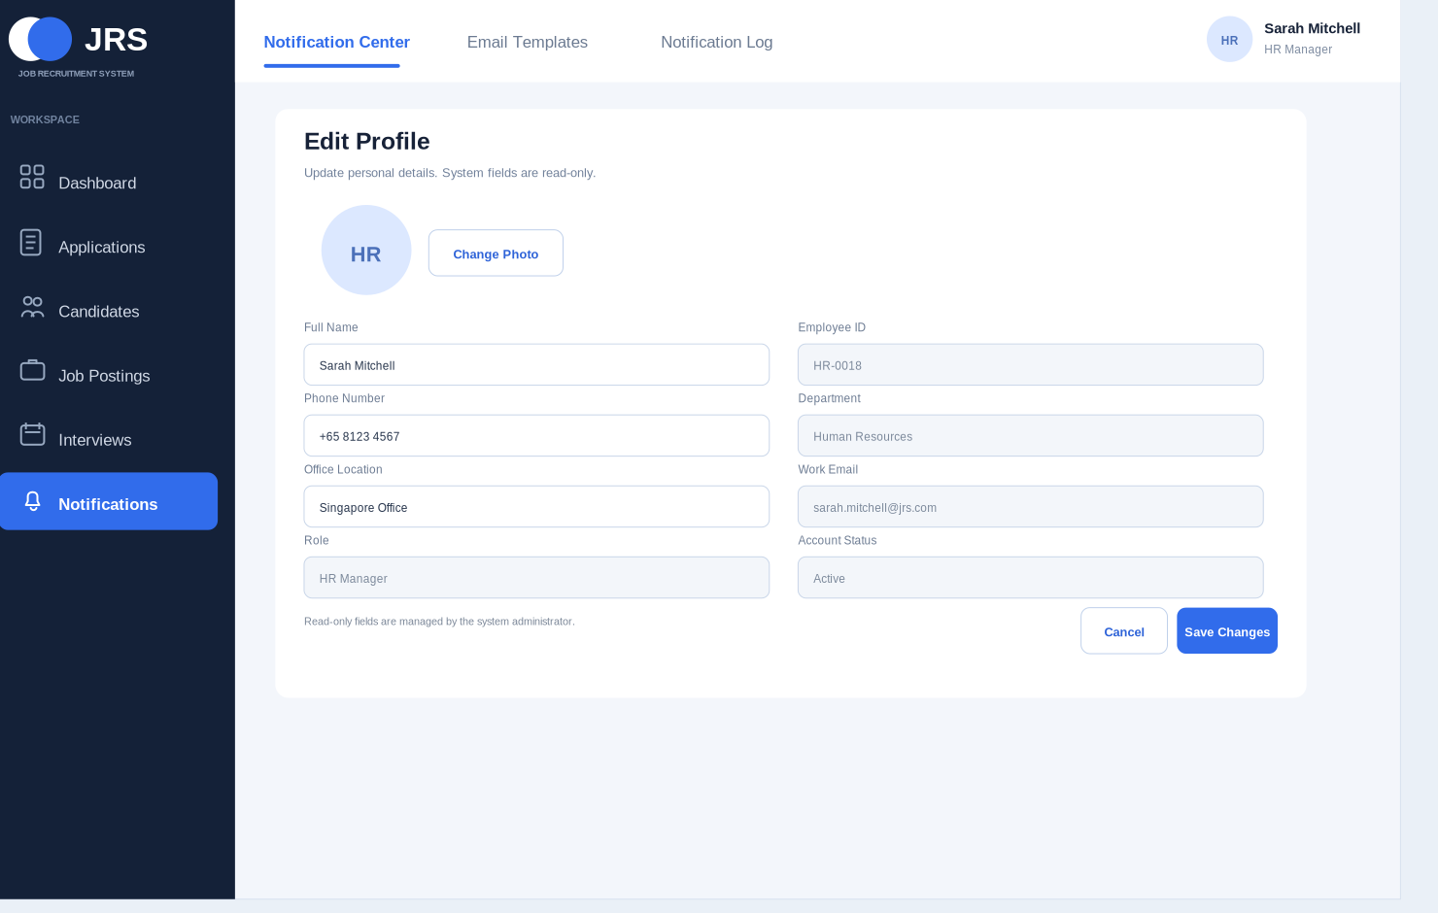
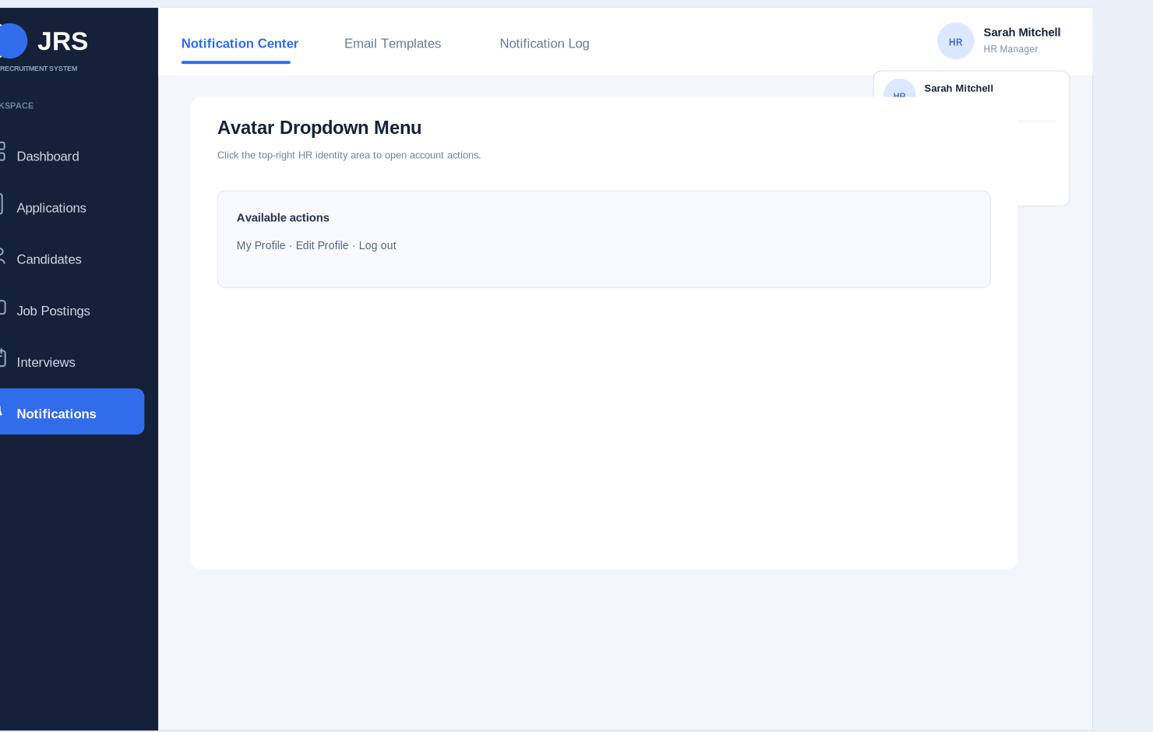
HR Profile and avatar menu
Profile area separates editable personal details from official work information controlled by the organization.
JRS Individual Presentation | Zhao Yikai
7
Notes:
I noticed that the HR name and avatar in the top-right corner looked interactive, but there was no account function behind them. To complete this part of the interface, I added a simple account menu that leads to the profile and edit pages. HR users can update their basic personal details, while official work information remains protected by the system. I believe that this is consistent with real corporate systems.

Slide 8
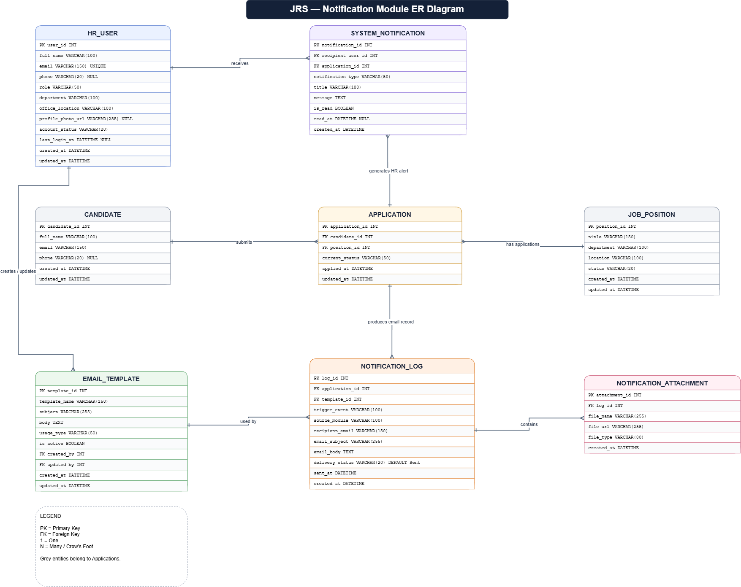
ER model and database relationships
Design focus
The model connects each notification and email to the correct recruitment record, so the front end can later load real data from the database.
Candidate and application are traceable
Profile details have a clear place
Attachments can be linked to sent messages
JRS Individual Presentation | Zhao Yikai
8
Notes:
For the database design, I mainly considered how the notification module would work with the rest of the system. Each notification or email is connected to the relevant candidate and application, so HR can follow the full record when needed. I also planned where profile information and attachments would be stored. Once the system is connected to real data, HR will be able to open a message and quickly find the related recruitment record.

Slide 9
Self-learning and project management
Self-learning
Project management
How recruitment workflow parts connect
Team discussions helped refine scope
How to define clearer module boundaries
Supervisor feedback guided corrections
How to keep interface style consistent
Early delivery allowed revision time
How the prototype prepares for Part B
Final module is ready for database integration
Part B goal: connect static pages to APIs, SQL data, authentication, and role-based access control.
JRS Individual Presentation | Zhao Yikai
9
Notes:
Through this project, I learned how different parts of a recruitment system should work together, and how important it is to keep the design consistent. Feedback from my team and supervisor helped me improve my work before the deadline, and the module is now ready for Part B. Thank you.

